Slide 1
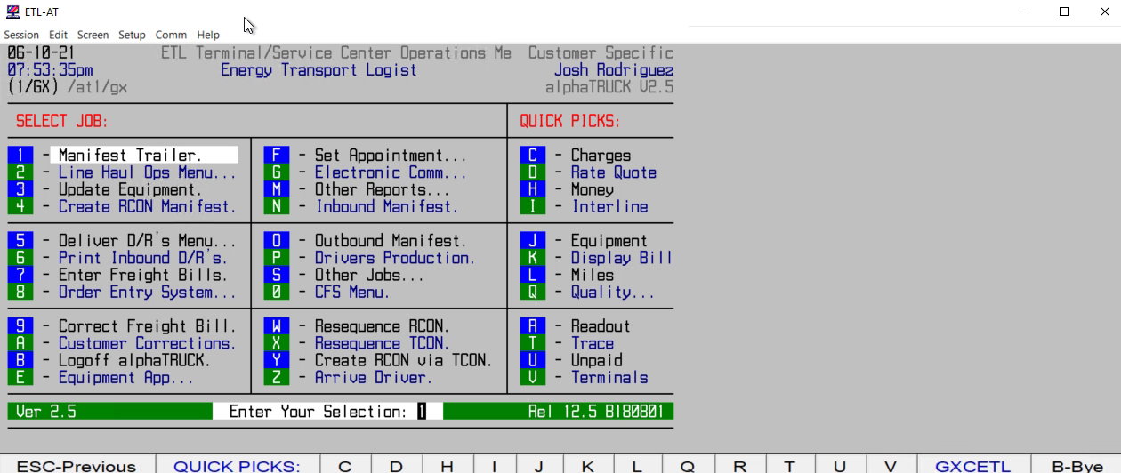
HOW TO VIEW INCOMING DRIVER/DISPATCHES/MANIFESTS

