Slide 1
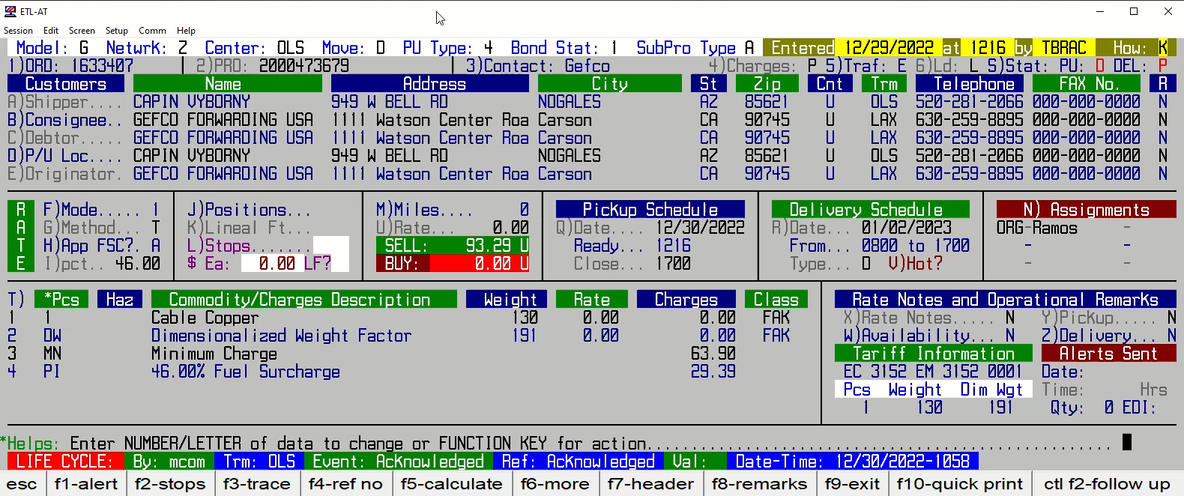
HOW TO UPDATE PCS AND WEIGHT

