Slide 1
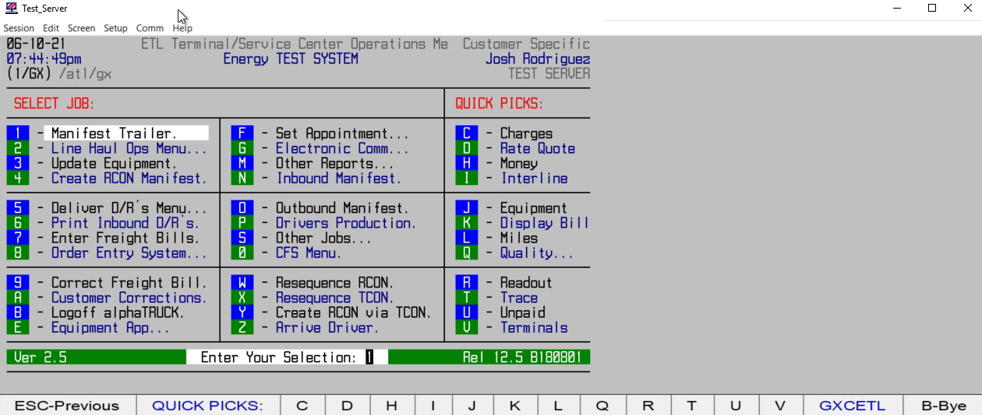
HOW TO SEND DELIVERIES TO DRIVERS VIA RCON

