Slide 1
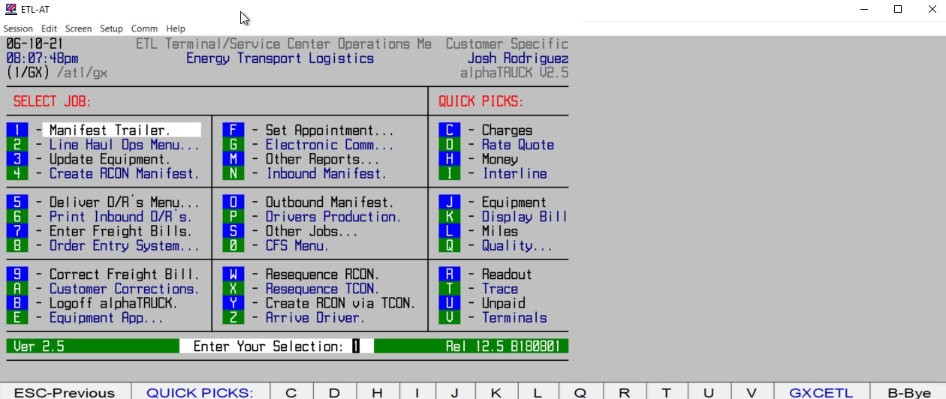
HOW TO VIEW/PRINT MISSING D/R REPORT

