Slide 1
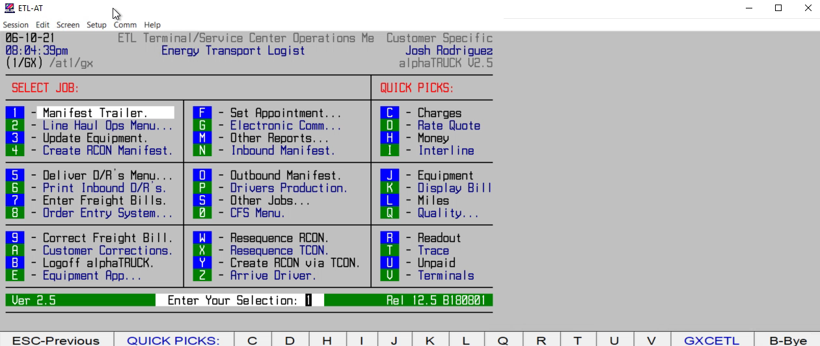
HOW TO RUN MISSING BOL IMAGE REPORT

