Slide 1
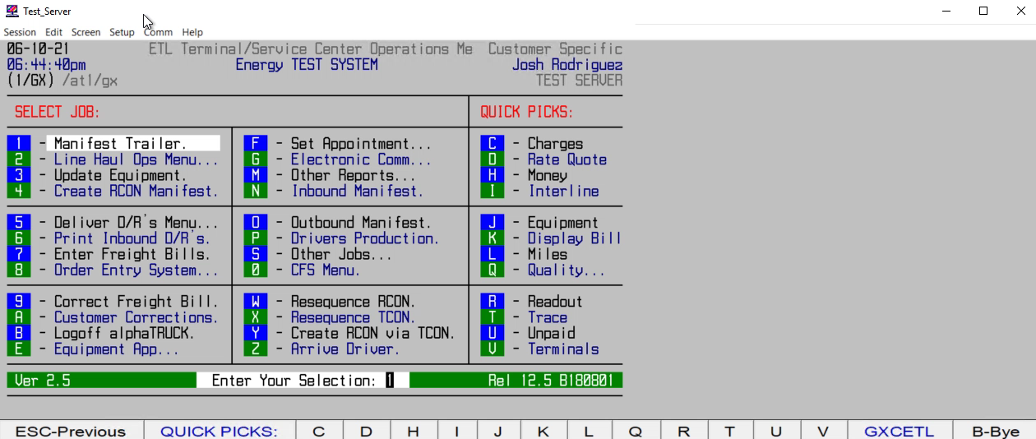
HOW TO FIND A SHIPMENT WITHOUT A PRO# (VIA MAWB,HBL,7512,REF#s, ETC.)

