Slide 1
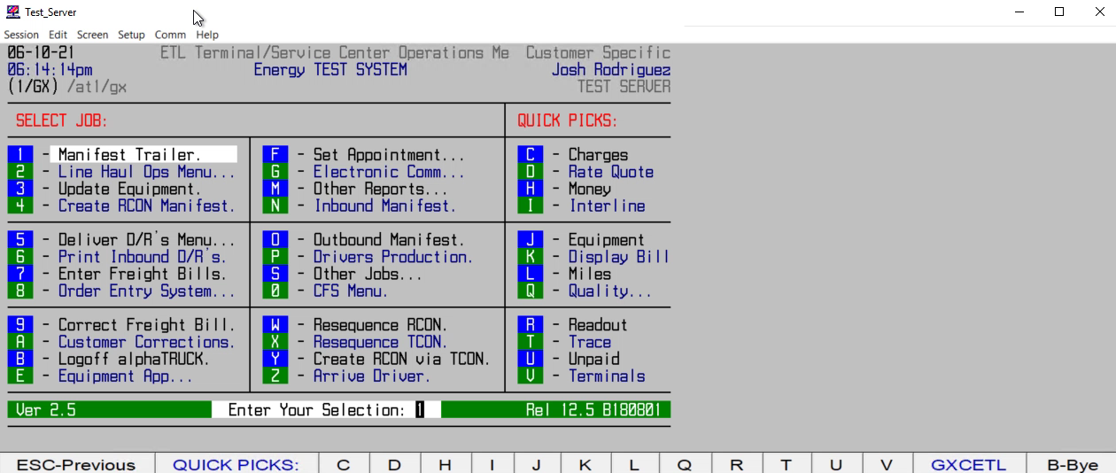
HOW TO ENTER POD/DELIVERY INFO

