Slide 1
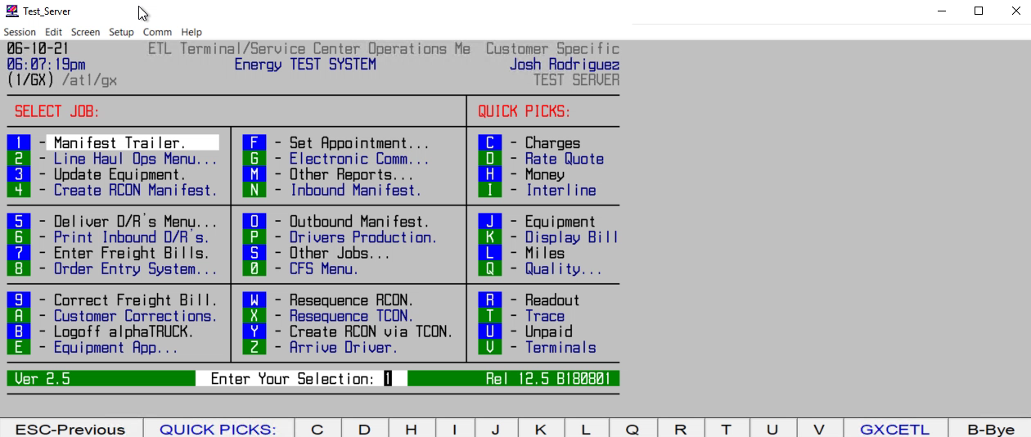
HOW TO EDIT A SHIPMENT
(NEW REF#s, NEW PU DATE, NEW SHIPPER, PC CT, WT, ETC.)

