Slide 1
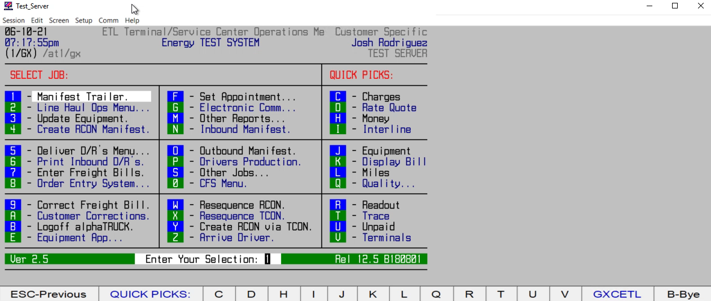
HOW TO CREATE AN OUTBOUND MANIFEST/TRAILER

