Slide 1
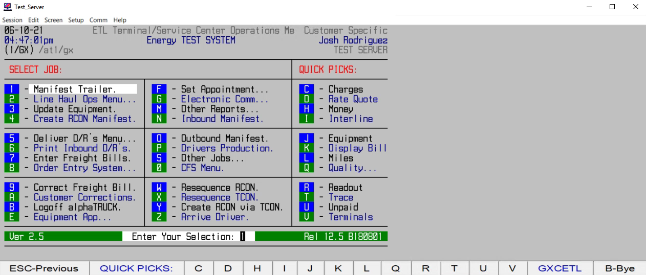
HOW TO CREATE A QUOTE W/ SHIPPER AND CNEE INFO

