Slide 1
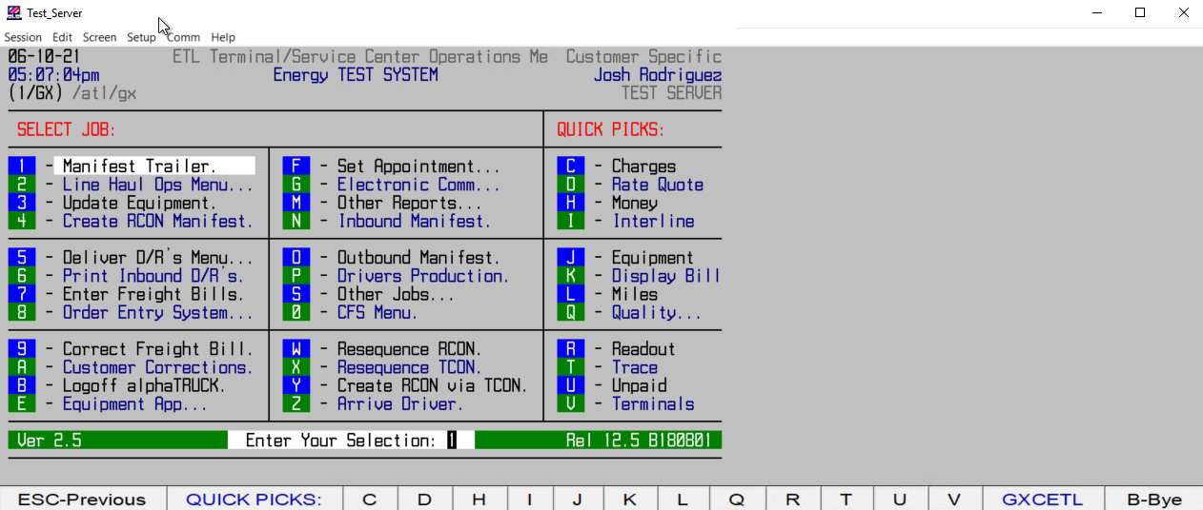
HOW TO CREATE A QUOTE W/ ZIP CODES ONLY

