Slide 1
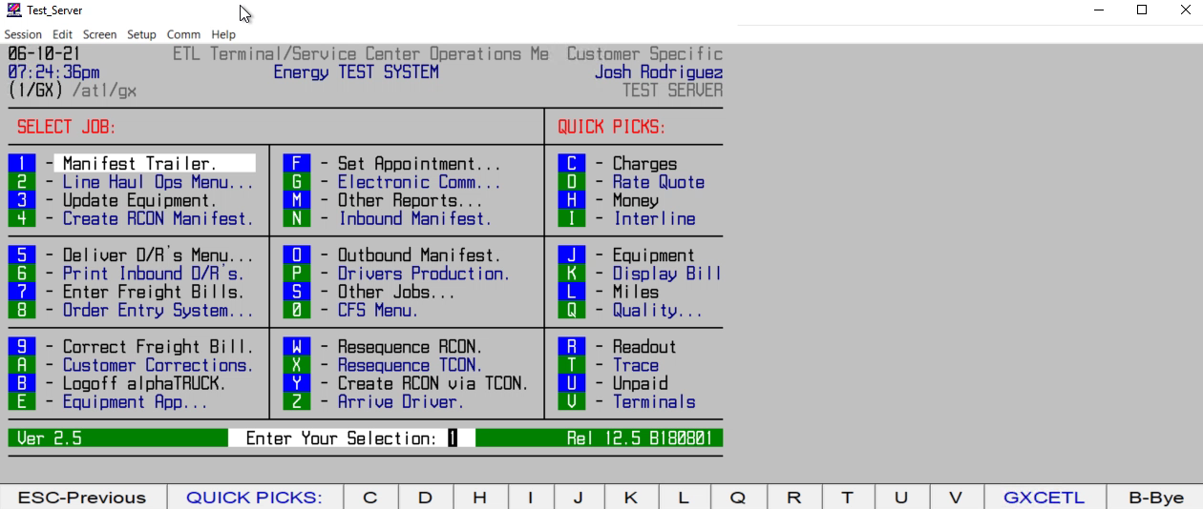
HOW TO CREATE A LINEHAUL/DISPATCH#

