Slide 1
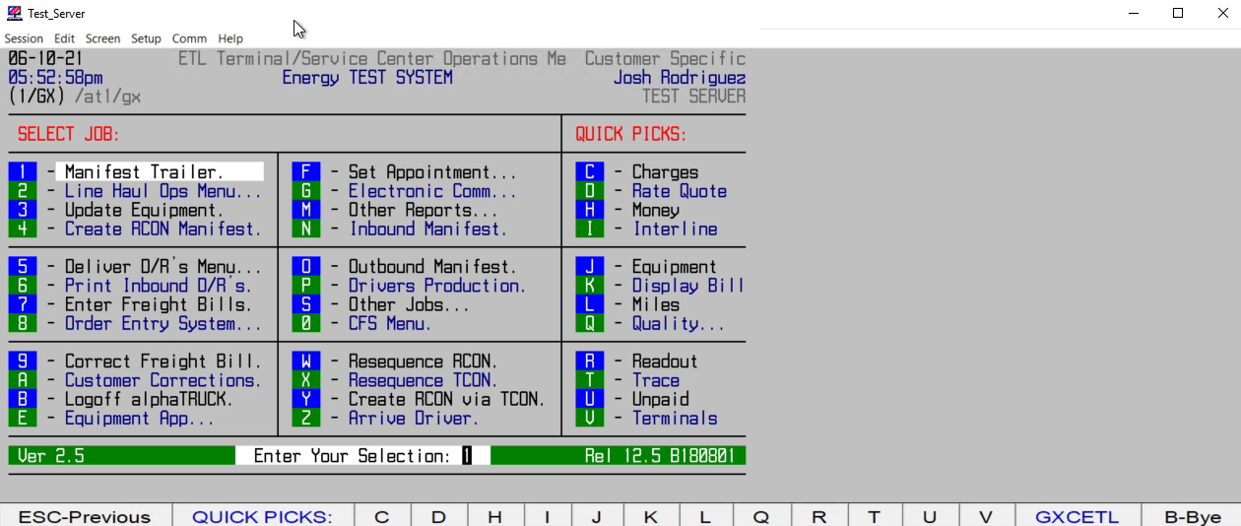
HOW TO BRING UP A DOWN PRINTER

