Slide 1
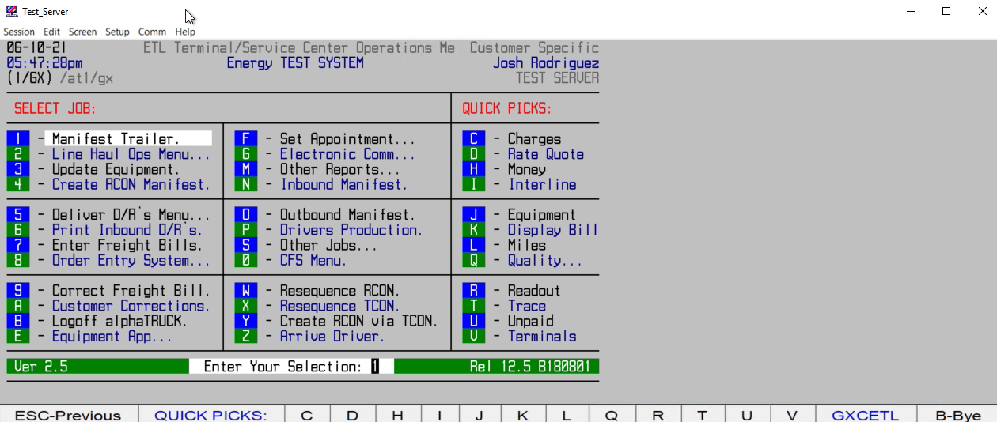
HOW TO ASSIGN A PICKUP TO A DRIVER

