Slide 1
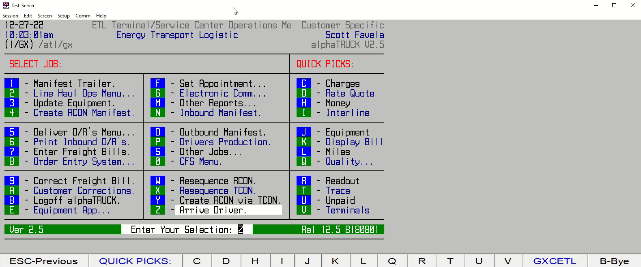
HOW TO ARRIVE A LOCAL DRIVER

