Slide 1
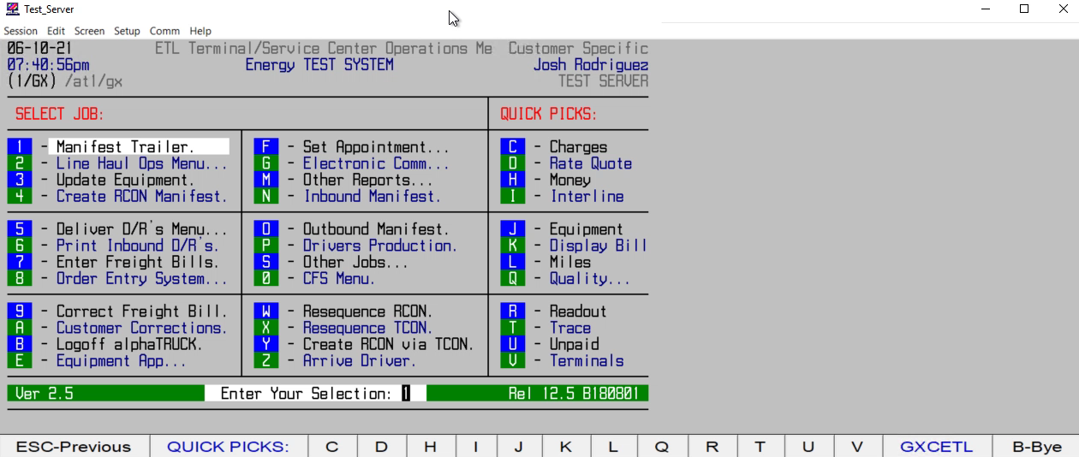
HOW TO ARRIVE AN INBOUND MANIFEST

