Slide 1
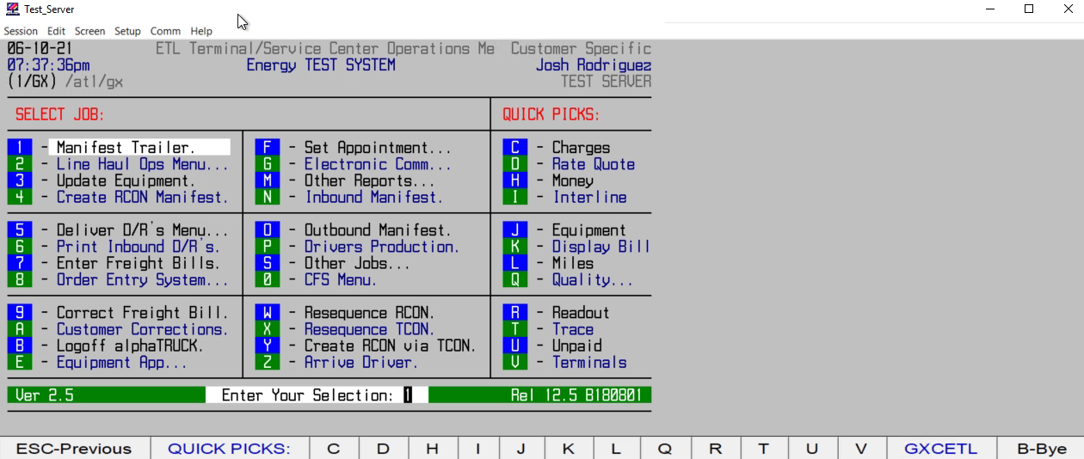
HOW TO ARRIVE A
DISPATCH# / DRIVER

