Slide 1
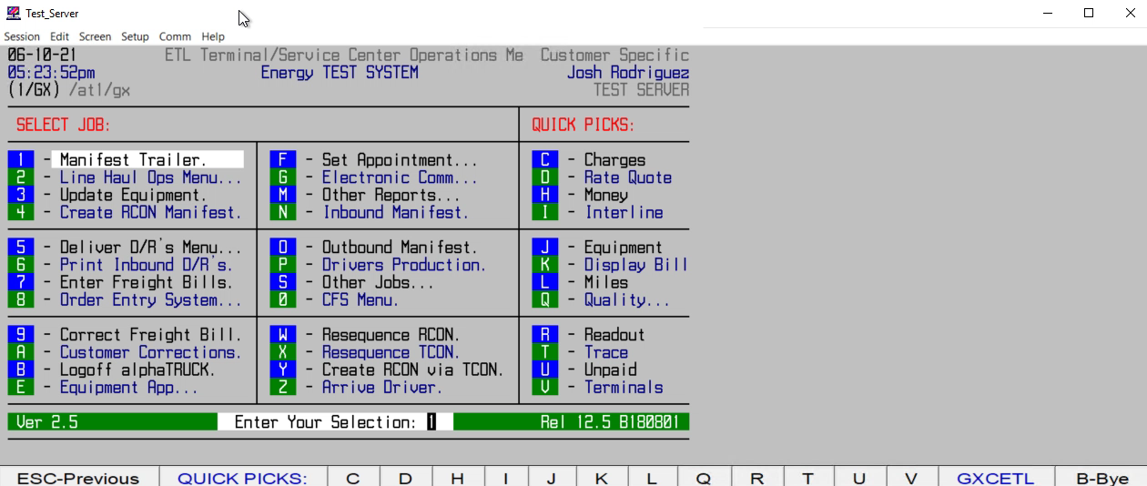
HOW TO APPROVE/DISPATCH A QUOTE #

