Slide 1
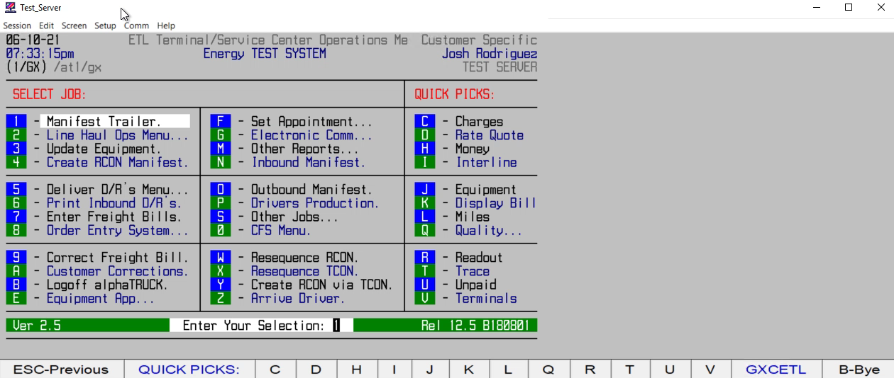
HOW TO ADD AN ADDITIONAL LEG ON A DISPATCH#

