Slide 1
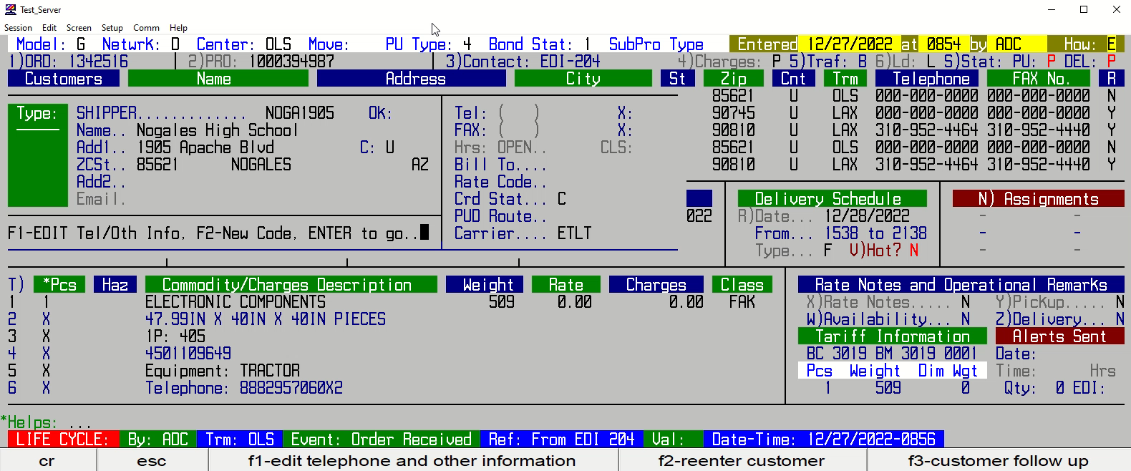
CREATING AN ACCOUNT CODE

