Slide 1
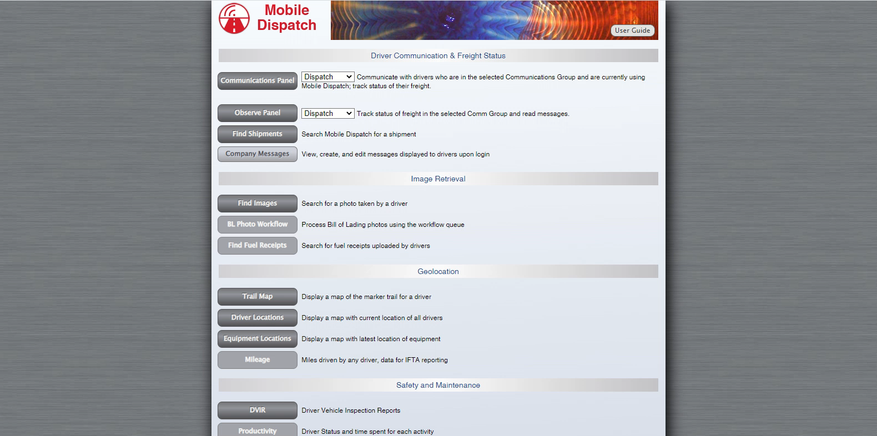
ACORDEX DISPATCH COMMUNICATIONS

